Slide 1

GENERATIVE AI
Thinking Models
vs
Instruct Models
A Practical Comparison Using Math, Coding and General Knowledge Tasks
GROUP 2
Project Team –3 Members
* NUPUR SHARMA
* KARTHIK BETAGERI
* DEVANSH AGRAWAL
DATE: 9th October,2026
Thinking Models vs Instruct Models | ExcelR GenAI Project
1

Slide 2
Models & Evaluation Methodology
Four models • three tasks • common performance metrics
Model | Type
DeepSeek-R1 | Thinking
o3-mini | Thinking
GPT-4o mini | Instruct
GPT-OSS-20B | Instruct
TASKS
METRICS
GSM8K — Math
HumanEval — Coding
General Knowledge
Accuracy
Average response time
Quality / Quality Proxy
Observable reasoning style
Evaluation pipeline
4 Models
3 Tasks
Metrics
Comparison
Same evaluation framework
Same evaluation framework
Same evaluation framework
Same evaluation framework
Note: GPT-OSS-20B was used as a free replacement for Llama-3.1 8B Instruct because Llama-3.1 8B Instruct was unavailable in the selected free/developer tier.
Thinking Models vs Instruct Models | ExcelR GenAI Project
2

Slide 3
GSM8K Accuracy — Mathematical Reasoning
50 questions evaluated; DeepSeek-R1 accuracy based on 48 successful responses
WINNER
GPT-4o mini
94% accuracy
KEY FINDING
The Thinking Model category did not automatically produce the highest mathematical accuracy.
SCORECARD
GSM8K Accuracy Scorecard
Thinking Models vs Instruct Models | ExcelR GenAI Project
3

Slide 4
HumanEval Accuracy — Coding Performance
25 selected coding problems; generated code checked for correctness and functionality
WINNER
GPT-OSS-20B
96% accuracy
KEY FINDING
HumanEval showed the largest performance gap among the four models.
SCORECARD
HumanEval Coding Scorecard
Thinking Models vs Instruct Models | ExcelR GenAI Project
4

Slide 5
General Knowledge — Accuracy, Speed & Quality
50 questions; all four models achieved 100% accuracy
Model | Accuracy | Avg. Time | Quality
DeepSeek-R1 | 100% | 18.70 s | 5.0
GPT-4o mini | 100% | 1.02 s | 5.0
GPT-OSS-20B | 100% | 0.53 s | 5.0
o3-mini | 100% | 1.81 s | 5.0
KEY FINDING
FASTEST
Because accuracy was identical, response time became the main differentiator.
GPT-OSS-20B — 0.53 seconds average
SCORECARD
General Knowledge Performance Scorecard
Thinking Models vs Instruct Models | ExcelR GenAI Project
5

Slide 6
Response Time — Speed Comparison
HumanEval average response time
FASTEST
GPT-OSS-20B
1.11 seconds
SLOWEST
DeepSeek-R1
64.39 seconds
SCORECARD
Response Time Scorecard — HumanEval
Thinking Models vs Instruct Models | ExcelR GenAI Project
6

Slide 7
Overall Model Comparison
Task accuracy, speed and observable response style
Model | GSM8K | HumanEval | GK | Speed / Week 3 | Response style
DeepSeek-R1 | 89.58% | 80% | 100% | Slowest | More detailed
o3-mini | 92% | 24% | 100% | Moderate | More concise
GPT-4o mini | 94% | 92% | 100% | Good | Balanced
GPT-OSS-20B | 92% | 96% | 100% | Fastest | Direct
BEST GSM8K
BEST CODING
OVERALL
GPT-4o mini — 94%
GPT-OSS-20B — 96%
No single model wins every task
Thinking Models vs Instruct Models | ExcelR GenAI Project
7

Slide 8
Thinking Models vs Instruct Models
Observed response style and measured performance
THINKING MODELS
INSTRUCT MODELS
DeepSeek-R1 + o3-mini
• More reasoning-oriented response styles
• DeepSeek-R1: generally more detailed
• o3-mini: generally more concise
• Performance varied by task
Useful when reasoning-oriented interaction or response style is important.
GPT-4o mini + GPT-OSS-20B
• Strong practical accuracy in evaluated tasks
• Strong response speed in Week 3
• GPT-OSS-20B: fastest in HumanEval and GK
• GPT-4o mini: strongest general balance
Useful when direct, efficient task completion is the priority.
SCORECARD • Model-Type Comparison
The project does not show that one model type is universally better.
Thinking Models vs Instruct Models | ExcelR GenAI Project
8

Slide 9
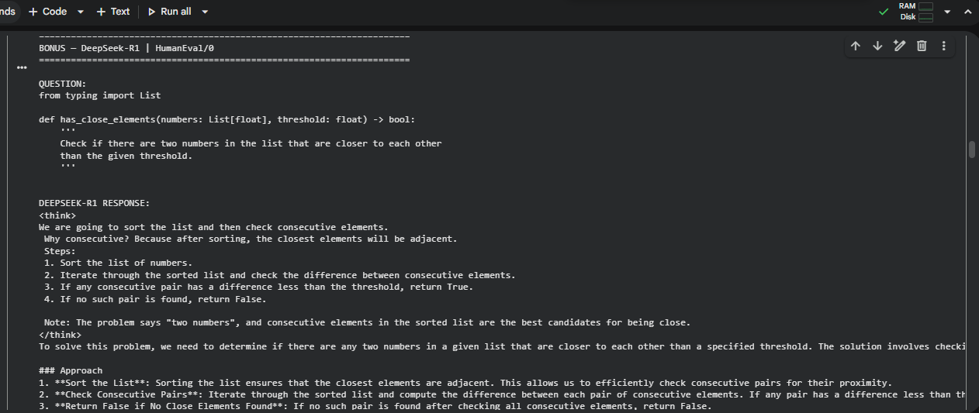
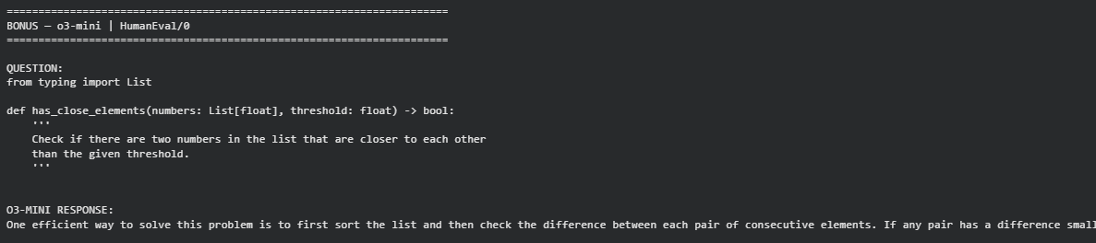
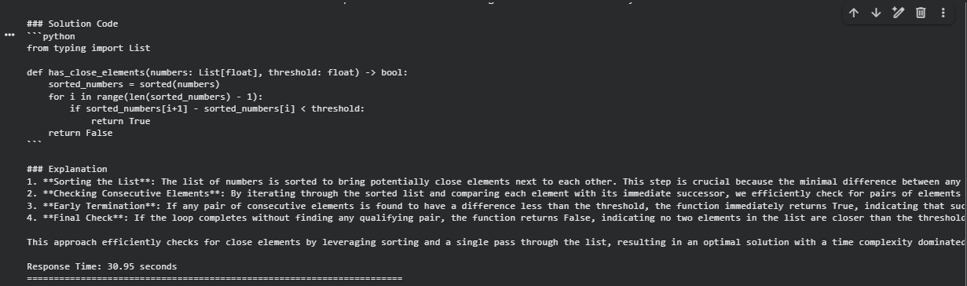
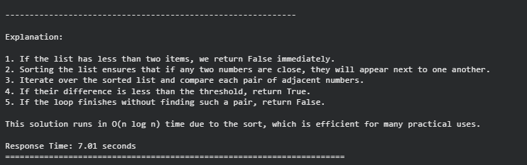
Thinking Models Response (Reasoning) Screenshots
Bonus: Observable reasoning-style examples from HumanEval
DeepSeek-R1
o3-mini
More detailed reasoning-style response
More concise reasoning-style response
Observation: DeepSeek-R1 produced a more detailed, step-by-step response, while o3-mini was comparatively concise.
Thinking Models vs Instruct Models | ExcelR GenAI Project
9

Slide 10
Which Model Should Be Used Where?
Recommendations derived from the measured results in this project
GPT-4o mini — GENERAL STUDENT CHATBOT
GPT-OSS-20B — CODING + SPEED
94% GSM8K • 92% HumanEval • 100% GK
Best balance of accuracy, quality and response time.
96% HumanEval • 1.11 s HumanEval • 0.53 s GK
Strong choice when coding and fast responses matter.
DeepSeek-R1 — DETAILED REASONING STYLE
o3-mini — CONCISE RESPONSES
Generally more detailed observable responses.
Useful when a detailed reasoning-oriented style is preferred; slower in this evaluation.
Generally more concise responses.
Suitable when concise interaction is preferred, but HumanEval accuracy was 24% in this evaluation.
SCORECARD • Use-Case Recommendation
Thinking Models vs Instruct Models | ExcelR GenAI Project
10

Slide 11

Conclusion
There is no single best model for every task.
Model selection should depend on the application's requirements for accuracy, speed, quality and response style.
GENERAL CHATBOT
CODING + SPEED
DETAILED STYLE
CONCISE STYLE
GPT-4o mini
GPT-OSS-20B
DeepSeek-R1
o3-mini
For a general-purpose student chatbot, GPT-4o mini is the preferred choice in this project; GPT-OSS-20B is the strongest alternative for coding-focused, fast-response use cases.
SCORECARD • Final Recommendation
Thinking Models vs Instruct Models | ExcelR GenAI Project
11

Slide 12

THANK YOU
ANY QUESTIONS?
Thinking Models vs Instruct Models | ExcelR GenAI Project
12

